Slide 1
Computer Networks (CS-241)
Dr Syed Muhammad Mohsin
Department of Computer Science,
University of Wah
Adapted From:
Computer Networking: A Top-Down Approach 8th edition: Jim Kurose, Keith Ross Pearson, 2020

Slide 2
Processes communicating
process: program running within a host (executing version of a program)
When two or more processes exchange data or messages to perform a task, this is called process communication.
clients, servers
client process: process that initiates communication
server process: process that waits to be contacted

Slide 3
Types of Process Communication
1. Inter-Process Communication (IPC) – Same Machine
Used when processes run on the same system.
Example: A text editor process sending data to a spell-checking process on the same computer.

Slide 4
Types of Process Communication
2. Network Process Communication – Across Machines
Happens over a network (like the Internet).
Processes use sockets to send and receive data through ports.
Relies on client–server architecture or peer-to-peer models.
Example: When you use WhatsApp, your phone’s app (client process) communicates with WhatsApp’s server process to send or receive messages.

Slide 5

Sockets
A socket is like a communication endpoint — it allows two processes (programs) to send and receive data across a network.
Think of it as a door through which data enters or leaves your computer during communication.
application
socket
application
controlled by
app developer
process
process
transport
transport
network
network
controlled
by OS
link
Internet
link
physical
physical

Slide 6
Sockets
A socket is an interface provided by the Operating System that enables communication between:
Processes on the same system (using IPC), or
Processes on different systems connected over a network (using IP and ports). A socket combines:
IP address + Port number to uniquely identify a communication endpoint.
Example:
192.168.1.10 → IP address of the host
80 → Port number for HTTP service

Slide 7
Real-Life Examples of Sockets
Application | Port | Protocol
HTTP (Web) | 80 | TCP
HTTPS (Secure Web) | 443 | TCP
DNS | 53 | UDP
FTP | 21 | TCP
WhatsApp | Dynamic ports | TCP/UDP

Slide 8
An application-layer protocol defines:
types of messages exchanged,
e.g., request, response
message syntax:
what fields in messages & how fields are delineated (described)
message semantics
meaning of information in fields
rules for when and how processes send & respond to messages
1. Open protocols:
defined in RFCs, everyone has access to protocol definition
allows for interoperability
e.g., HTTP, SMTP
2. Proprietary protocols:
e.g., Skype, Zoom

Slide 9

Application layer: overview
P2P applications
video streaming and content distribution networks
socket programming with UDP and TCP
Principles of network applications
Web and HTTP
E-mail, SMTP, IMAP
The Domain Name System DNS

Slide 10
Web and HTTP
First, a quick review…
web page consists of objects, each of which can be stored on different Web servers
object can be HTML file, JPEG image, Java applet, audio file,…
web page consists of base HTML-file which includes several referenced objects, each addressable by a URL, e.g.,
www.someschool.edu/someDept/pic.gif
host name
path name

Slide 11

HTTP overview
HTTP: hypertext transfer protocol
Web’s application layer protocol
client/server model:
client: browser (chorme, firefox etc.) that requests, receives, (using HTTP protocol) and “displays” Web objects
server: Web server sends (using HTTP protocol) objects in response to requests
HTTP request
PC running
Firefox browser
HTTP response
HTTP request
server running
Apache Web
server
HTTP response
iPhone running
Safari browser

Slide 12
HTTP overview (continued)
HTTP uses TCP:
client initiates TCP connection (creates socket) to server, port 80
server accepts TCP connection from client
HTTP messages (application-layer protocol messages) exchanged between browser (HTTP client) and Web server (HTTP server)
TCP connection closed
Downloading multiple objects requires multiple connections
HTTP is “stateless”
server maintains no information about past client requests
aside
protocols that maintain “state” are complex!
past history (state) must be maintained
if server/client crashes, their views of “state” may be inconsistent, must be reconciled

Slide 13
HTTP connections: two types
Non-persistent HTTP
TCP connection opened
at most one object sent over TCP connection
TCP connection closed
downloading multiple objects required multiple connections
Persistent HTTP
TCP connection opened to a server
multiple objects can be sent over single TCP connection between client, and that server
TCP connection closed

Slide 14
Non-persistent HTTP in operation: example
User enters URL:
www.someSchool.edu/someDepartment/home.index
(containing text, references to 10 jpeg images)
1a. HTTP client initiates TCP connection to HTTP server (process) at www.someSchool.edu on port 80
1b. HTTP server at host www.someSchool.edu waiting for TCP connection at port 80 “accepts” connection, notifying client
2. HTTP client sends HTTP request message (containing URL) into TCP connection socket. Message indicates that client wants object someDepartment/home.index
3. HTTP server receives request message, forms response message containing requested object, and sends message into its socket
time

Slide 15
Non-persistent HTTP in operation: example (cont.)
User enters URL:
www.someSchool.edu/someDepartment/home.index
(containing text, references to 10 jpeg images)
4. HTTP server closes TCP connection.
5. HTTP client receives response message containing html file, displays html. Parsing html file, finds 10 referenced jpeg objects
6. Steps 1-5 repeated for each of 10 jpeg objects
time

Slide 16
Non-persistent HTTP: response time
RTT (definition): time for a small packet to travel from client to server and back
HTTP response time (per object):
one RTT to initiate TCP connection
one RTT for HTTP request and first few bytes of HTTP response to return
obect/file transmission time
initiate TCP
connection
RTT
request file
RTT
time to
transmit
file
file received
time
time
Non-persistent HTTP response time = 2RTT+ file transmission time

Slide 17
Persistent HTTP (HTTP 1.1)
Non-persistent HTTP issues:
requires 2 RTTs per object
OS overhead for each TCP connection
browsers often open multiple parallel TCP connections to fetch referenced objects in parallel
Persistent HTTP (HTTP1.1):
server leaves connection open after sending response
subsequent HTTP messages between same client/server sent over open connection
client sends requests as soon as it encounters a referenced object
as little as one RTT for all the referenced objects (cutting response time in half)

Slide 18
HTTP request message
two types of HTTP messages: 1) request and 2) response
HTTP request message:
ASCII (human-readable format)
carriage return character
line-feed character
request line (GET, POST,
HEAD commands)
GET /index.html HTTP/1.1\r\n
Host: www-net.cs.umass.edu\r\n
User-Agent: Firefox/3.6.10\r\n
Accept: text/html,application/xhtml+xml\r\n
Accept-Language: en-us,en;q=0.5\r\n
Accept-Encoding: gzip,deflate\r\n
Accept-Charset: ISO-8859-1,utf-8;q=0.7\r\n
Keep-Alive: 115\r\n
Connection: keep-alive\r\n
\r\n
header
lines
carriage return, line feed at start of line indicates end of header lines
* Check out the online interactive exercises for more examples: http://gaia.cs.umass.edu/kurose_ross/interactive/

Slide 19
HTTP request message: general format
method
sp
URL
sp
version
cr
lf
request
line
header field name
value
cr
lf
~
~
header
lines
~
~
header field name
value
cr
lf
cr
lf
~
entity body
~
body
~
~

Slide 20
Other HTTP request messages
POST method:
web page often includes form input
user input sent from client to server in entity body of HTTP POST request message
HEAD method:
requests headers (only) that would be returned if specified URL were requested with an HTTP GET method.
PUT method:
uploads new file (object) to server
completely replaces file that exists at specified URL with content in entity body of POST HTTP request message
GET method (for sending data to server):
include user data in URL field of HTTP GET request message (following a ‘?’):
www.somesite.com/animalsearch?monkeys&banana

Slide 21
HTTP response message
status line (protocol
status code status phrase)
HTTP/1.1 200 OK\r\n
Date: Sun, 26 Sep 2010 20:09:20 GMT\r\n
Server: Apache/2.0.52 (CentOS)\r\n
Last-Modified: Tue, 30 Oct 2007 17:00:02 GMT\r\n
ETag: "17dc6-a5c-bf716880"\r\n
Accept-Ranges: bytes\r\n
Content-Length: 2652\r\n
Keep-Alive: timeout=10, max=100\r\n
Connection: Keep-Alive\r\n
Content-Type: text/html; charset=ISO-8859-1\r\n
\r\n
data data data data data ...
header
lines
data, e.g., requested
HTML file
* Check out the online interactive exercises for more examples: http://gaia.cs.umass.edu/kurose_ross/interactive/

Slide 22
HTTP response status codes
status code appears in 1st line in server-to-client response message.
some sample codes:
200 OK
request succeeded, requested object later in this message
301 Moved Permanently
requested object moved, new location specified later in this message (in Location: field)
400 Bad Request
request msg not understood by server
404 Not Found
requested document not found on this server
505 HTTP Version Not Supported

Slide 23
Maintaining user/server state: cookies
Web sites and client browser use cookies to maintain some state between transactions
four components:
1) cookie header line of HTTP response message
2) cookie header line in next HTTP request message
3) cookie file kept on user’s host, managed by user’s browser
4) back-end database at Web site
Example:
Susan uses browser on laptop, visits specific e-commerce site for first time
when initial HTTP requests arrives at site, site creates:
unique ID (aka “cookie”)
entry in backend database for ID
subsequent HTTP requests from Susan to this site will contain cookie ID value, allowing site to “identify” Susan
Notes:
t’

Slide 24
Maintaining user/server state: cookies
client
server
ebay 8734
usual HTTP request msg
Amazon server
creates ID
1678 for user
cookie file
usual HTTP response
set-cookie: 1678
backend
database
create
entry
ebay 8734
amazon 1678
usual HTTP request msg
cookie: 1678
cookie-
specific
action
access
usual HTTP response msg
one week later:
access
ebay 8734
amazon 1678
usual HTTP request msg
cookie: 1678
cookie-
specific
action
usual HTTP response msg
time
time
Notes:
t’

Slide 25
HTTP cookies: comments
aside
What cookies can be used for:
authorization
shopping carts
recommendations
user session state (Web e-mail)
cookies and privacy:
cookies permit sites to learn a lot about you on their site.
third party persistent cookies (tracking cookies) allow common identity (cookie value) to be tracked across multiple web sites
Challenge: How to keep state:
protocol endpoints: maintain state at sender/receiver over multiple transactions
cookies: HTTP messages carry state
Notes:
t’

Slide 26

Web caches (proxy servers)
Goal: satisfy client request without involving origin server
user configures browser to point to a Web cache
browser sends all HTTP requests to cache
if object in cache: cache returns object to client
else cache requests object from origin server, caches received object, then returns object to client
proxy
server
HTTP request
HTTP request
client
HTTP response
HTTP response
origin
server
HTTP request
HTTP response
client
origin
server
Notes:
t’

Slide 27
Web caches (proxy servers)
Web cache acts as both client and server
server for original requesting client
client to origin server
typically cache is installed by ISP (university, company, residential ISP)
Why Web caching?
reduce response time for client request
cache is closer to client
reduce traffic on an institution’s access link
Internet is dense with caches
enables “poor” content providers to more effectively deliver content
Notes:
re: poor content providers – like in real-estate, location is everything. servers want to be close to clients.

Slide 28
HTTP/2
Key goal: decreased delay in multi-object HTTP requests
HTTP1.1: introduced multiple, pipelined GETs over single TCP connection
server responds in-order (FCFS: first-come-first-served scheduling) to GET requests
with FCFS, small object may have to wait for transmission (head-of-line (HOL) blocking) behind large object(s)
loss recovery (retransmitting lost TCP segments) stalls object transmission
Notes:
t’

Slide 29
HTTP/2
Key goal: decreased delay in multi-object HTTP requests
HTTP/2: [RFC 7540, 2015] increased flexibility at server in sending objects to client:
methods, status codes, most header fields unchanged from HTTP 1.1
transmission order of requested objects based on client-specified object priority (not necessarily FCFS)
push unrequested objects to client
divide objects into frames, schedule frames to mitigate HOL blocking
Notes:
t’

Slide 30
HTTP/2 to HTTP/3
Key goal: decreased delay in multi-object HTTP requests
HTTP/2 over single TCP connection means:
recovery from packet loss still stalls all object transmissions
as in HTTP 1.1, browsers have incentive to open multiple parallel TCP connections to reduce stalling, increase overall throughput
no security over vanilla TCP connection
HTTP/3: adds security , per object error- and congestion-control (more pipelining) over UDP
more on HTTP/3 in transport layer
Notes:
t’

Slide 31
Application layer: overview
P2P applications
video streaming and content distribution networks
socket programming with UDP and TCP
Principles of network applications
Web and HTTP
E-mail, SMTP, IMAP
The Domain Name System DNS

Slide 32
E-mail
outgoing
message queue
user mailbox
user
agent
Three major components:
user agents
mail servers
simple mail transfer protocol: SMTP
User Agent
a.k.a. “mail reader”
composing, editing, reading mail messages
e.g., Outlook, iPhone mail client
outgoing, incoming messages stored on server
mail
server
user
agent
SMTP
mail
server
user
agent
SMTP
SMTP
user
agent
mail
server
user
agent
user
agent

Slide 33
E-mail: mail servers
outgoing
message queue
user mailbox
user
agent
mail servers:
mailbox contains incoming messages for user
message queue of outgoing (to be sent) mail messages
SMTP protocol between mail servers to send email messages
client: sending mail server
“server”: receiving mail server
mail
server
user
agent
SMTP
mail
server
user
agent
SMTP
SMTP
user
agent
mail
server
user
agent
user
agent

Slide 34
E-mail: the RFC (5321)
uses TCP to reliably transfer email message from client (mail server initiating connection) to server, port 25
direct transfer: sending server (acting like client) to receiving server
three phases of transfer
handshaking (greeting)
transfer of messages
closure
command/response interaction (like HTTP)
commands: ASCII text
response: status code and phrase
messages must be in 7-bit ASCI

Slide 35


Scenario: Alice sends e-mail to Bob
1) Alice uses UA to compose e-mail message “to” bob@someschool.edu
4) SMTP client sends Alice’s message over the TCP connection
2) Alice’s UA sends message to her mail server; message placed in message queue
5) Bob’s mail server places the message in Bob’s mailbox
3) client side of SMTP opens TCP connection with Bob’s mail server
6) Bob invokes his user agent to read message
user
agent
mail
server
user
agent
1
mail
server
2
3
6
4
Alice’s mail server
5
Bob’s mail server

Slide 36
Sample SMTP interaction
S: 220 hamburger.edu
C: HELO crepes.fr
S: 250 Hello crepes.fr, pleased to meet you
C: MAIL FROM: <alice@crepes.fr>
S: 250 alice@crepes.fr... Sender ok
C: RCPT TO: <bob@hamburger.edu>
S: 250 bob@hamburger.edu ... Recipient ok
C: DATA
S: 354 Enter mail, end with "." on a line by itself
C: Do you like ketchup?
C: How about pickles?
C: .
S: 250 Message accepted for delivery
C: QUIT
S: 221 hamburger.edu closing connection

Slide 37
SMTP: closing observations
comparison with HTTP:
HTTP: pull
SMTP: push
both have ASCII command/response interaction, status codes
HTTP: each object encapsulated in its own response message
SMTP: multiple objects sent in multipart message
SMTP uses persistent connections
SMTP requires message (header & body) to be in 7-bit ASCII
SMTP server uses CRLF.CRLF to determine end of message

Slide 38
Mail message format
SMTP: protocol for exchanging e-mail messages, defined in RFC 531 (like HTTP)
RFC 822 defines syntax for e-mail message itself (like HTML)
header lines, e.g.,
To:
From:
Subject:
these lines, within the body of the email message area different from SMTP MAIL FROM:, RCPT TO: commands!
Body: the “message” , ASCII characters only
header
blank
line
body

Slide 39
Mail access protocols
user
agent
e-mail access
protocol
user
agent
SMTP
SMTP
(e.g., IMAP, HTTP)
sender’s e-mail
server
receiver’s e-mail
server
SMTP: delivery/storage of e-mail messages to receiver’s server
mail access protocol: retrieval from server
IMAP: Internet Mail Access Protocol [RFC 3501]: messages stored on server, IMAP provides retrieval, deletion, folders of stored messages on server
HTTP: gmail, Hotmail, Yahoo!Mail, etc. provides web-based interface on top of STMP (to send), IMAP (or POP) to retrieve e-mail messages

Slide 40
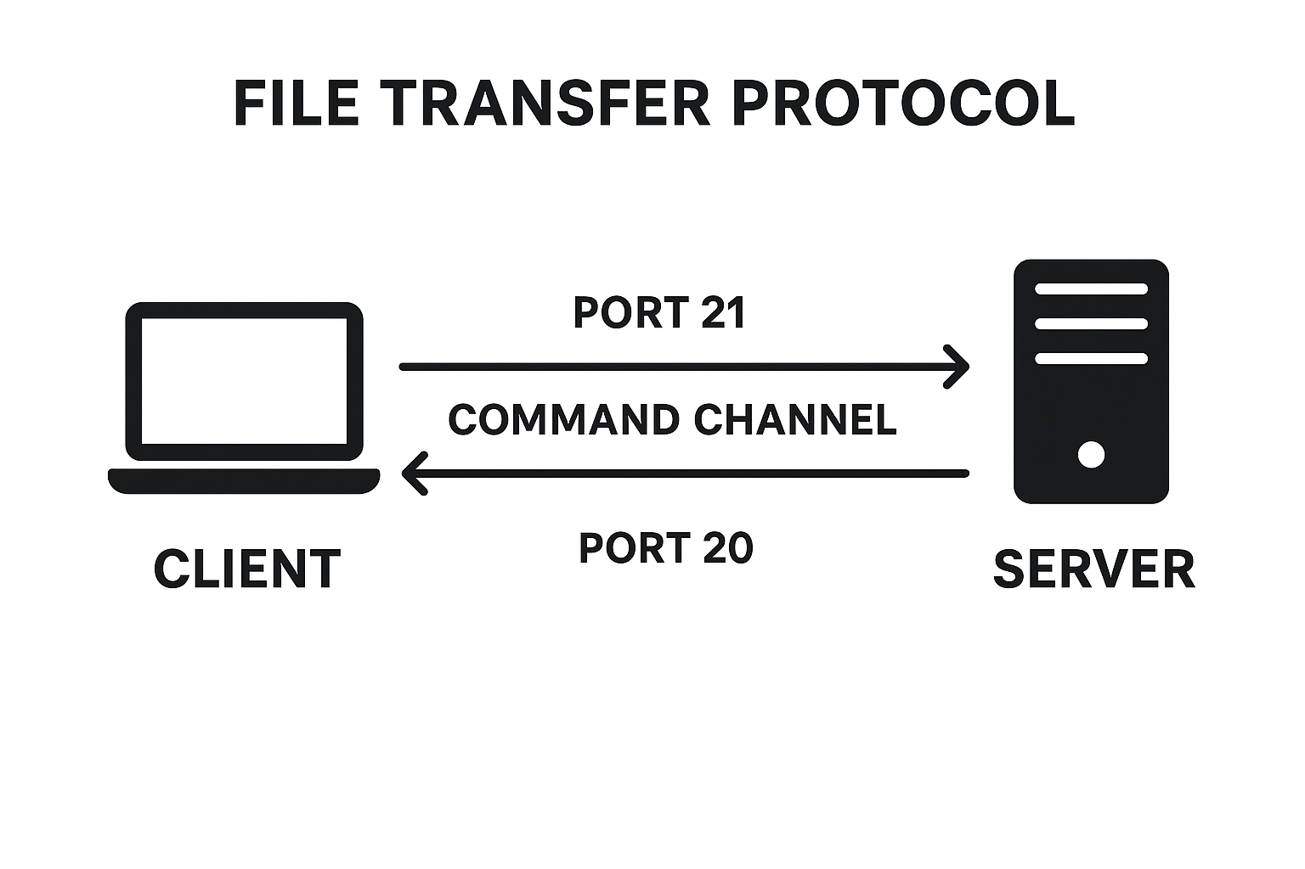
File Transfer Protocol (FTP)
FTP: It enables users to upload, download, delete, rename, move, and copy files on a remote server.
The client (your computer) connects to an FTP server using login credentials (username and password, or anonymously).
Once connected, the user can browse directories and transfer files between the local and remote systems. FTP uses two communication channels:
Command Channel (Port 21): Used for sending commands and responses.
Data Channel (Port 20 or other): Used for actual file transfer.

